Slide 1


FILM FLICKS FINDER

Slide 2
TEAM MEMBERS
AMAN DHIMAN (2200290140023)
AMAN KUMAR (2200290140024)
PROJECT SUPERVISOR
Ms. Divya Singhal (Assistant Professor)

Slide 3
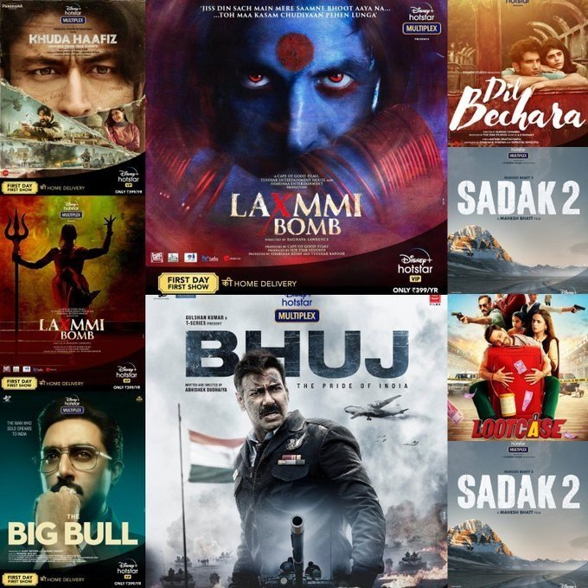
INTRODUCTION
In today's digital age, the abundance of entertainment options poses both a blessing and a challenge for consumers. With a plethora of movies available across various streaming platforms, finding content that aligns with individual preferences can be a daunting task. Movie recommendation systems emerge as a solution to this dilemma, aiming to streamline the selection process by providing personalized suggestions tailored to each user's tastes and preferences.
Traditionally, recommendation systems have relied on simplistic approaches such as collaborative filtering or content-based filtering.

Slide 4
TECHNOLOGIES
HTML5/CSS3
JavaScript
Express.js
Node.js
Graph Databases
Cloud Computing Platforms
Data Mining Techniques
Recommendation Algorithms:
Collaborative Filtering Techniques:
User-Based Collaborative Filtering
Item-Based Collaborative Filtering
Matrix Factorization Methods
Evaluation Metrics

Slide 5
HARDWARE USED
Intel core i3/i5/i7
Storage Systems
Distributed Computing Frameworks
GPUs (Graphics Processing Units)
Networking Equipment
Load Balancers
Memory :4GB/64GB
Cloud Infrastructure
High-Performance Computing (HPC) Clusters
Monitoring and Management Tools

Slide 6
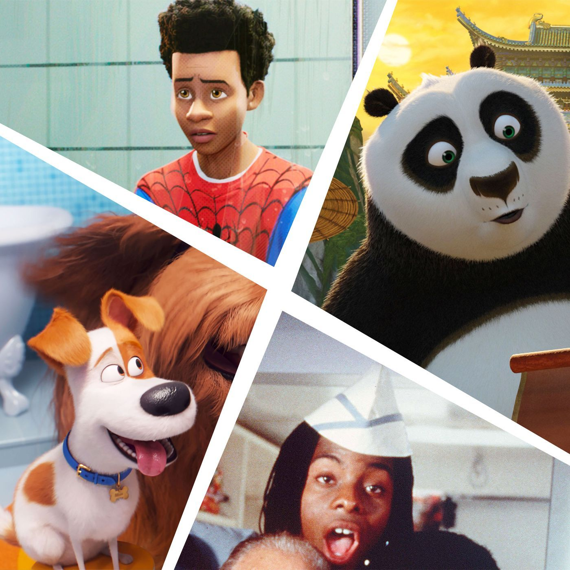
MODULES DESCRIPTION
Data Collection Module:
Description: This module gathers data from various sources such as user interactions, movie metadata, user reviews, and ratings.
Preprocessing Module:
Description: This module cleans and preprocesses the collected data to ensure consistency and quality.
User Profiling Module:
Description: This module creates user profiles based on their historical interactions, preferences, and demographic information.
Content-Based Filtering Module:
Description: This module recommends movies to users based on the similarity between the content of movies and user preferences.

Slide 7
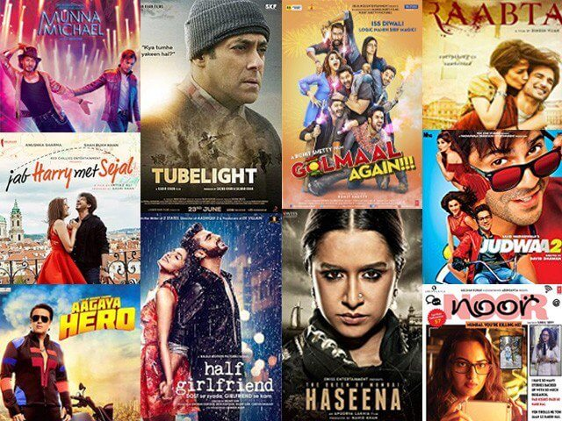
Collaborative Filtering Module:
Description: This module recommends movies to users based on their similarity to other users or items.
Hybrid Recommender Module:
Description: This module combines multiple recommendation approaches (e.g., content-based and collaborative filtering) to improve recommendation accuracy.
Deep Learning Module:
Description: This module employs deep learning models such as neural networks to learn complex patterns and representations from user data and movie features.
Evaluation Module:
Description: This module evaluates the performance of the recommendation system using various metrics and techniques.

Slide 8
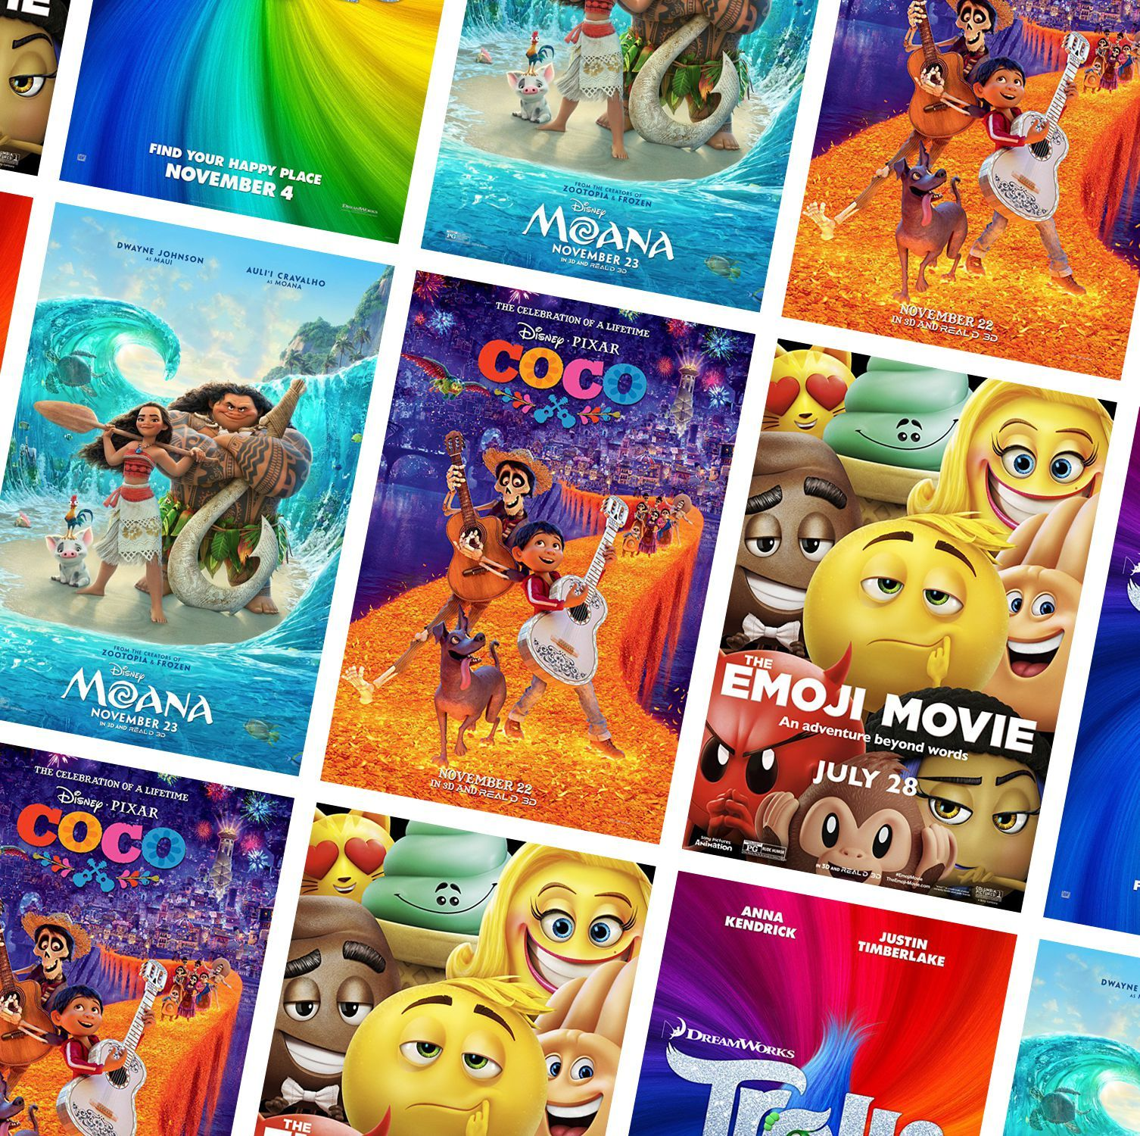
OUTPUT
Recommended Movies List
Ranked Recommendations
Similar Movies
User Ratings and Reviews
Personalized Recommendations
Recommendation Explanation
Recommendation Widgets or Widgets
Integration with User Interface
Real-time Updates
Cross-platform Integration

Slide 9
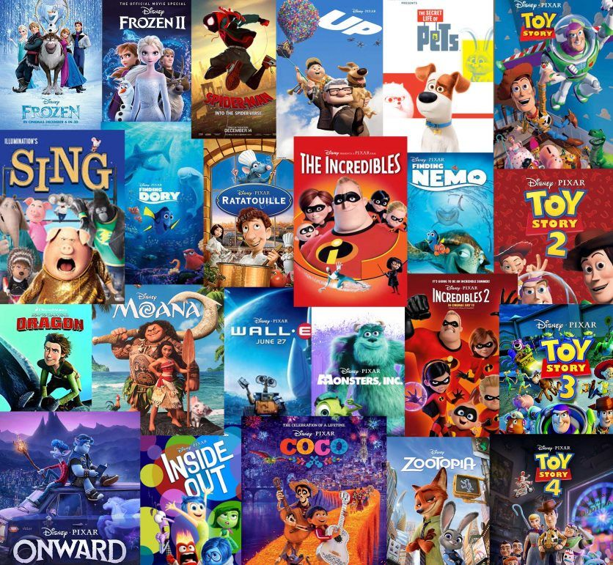
CONCLUSION
In conclusion, movie recommendation systems have become integral parts of modern entertainment platforms, leveraging advanced technologies to provide users with personalized and engaging movie suggestions. These systems utilize machine learning algorithms, data analysis techniques, and user feedback to deliver relevant recommendations tailored to individual preferences. By analyzing user behavior, movie attributes, and contextual information, recommendation systems offer a seamless and enjoyable movie-watching experience for users.
Through collaborative filtering, content-based filtering, and hybrid approaches, recommendation systems can overcome the challenge of information overload and help users discover new movies they are likely to enjoy.

Slide 10
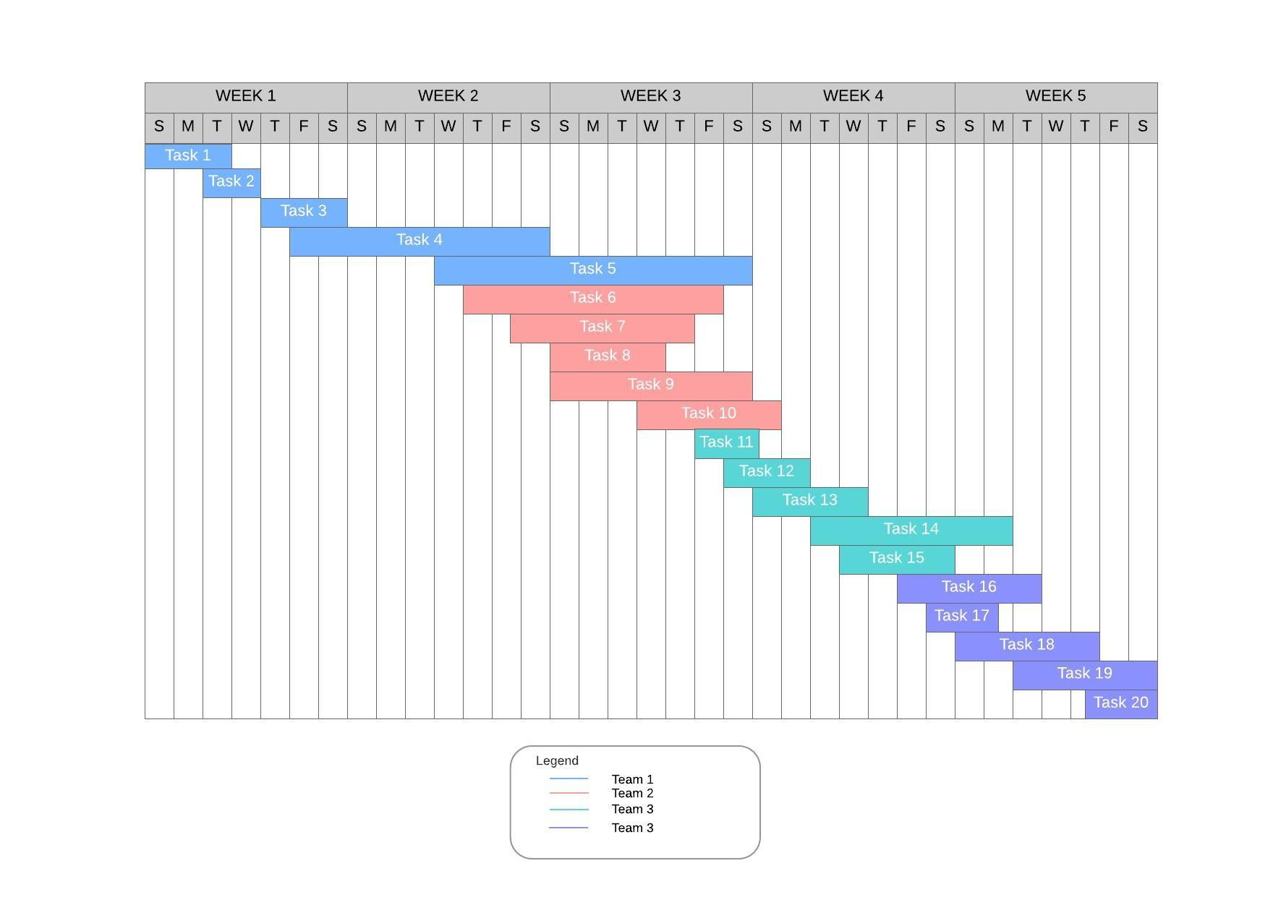
GANTT CHART

Slide 11


